Slide 1

Introduction to MLOps

Slide 2
1
What is Machine Learning (Recap)
2
Why MLOps
Agenda
3
What is HTTP
4
What is Docker
5
What is Kubernetes
6
Hands On

Slide 3

1
What is Machine Learning

Slide 4
2
Why MLOps

Slide 5

Why MLOps
“No users, no party”
Scalability
Reliability

Slide 6
3
What is HTTP

Slide 7
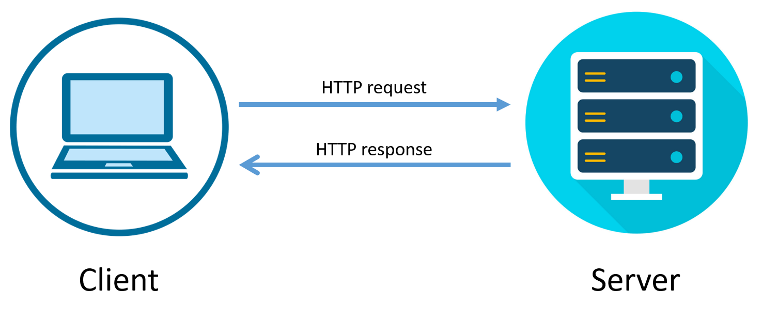
HTTP
Communication between client and server
Python libs: Flask, Django, FastAPI, etc.

Slide 8
4
What is Docker

Slide 9
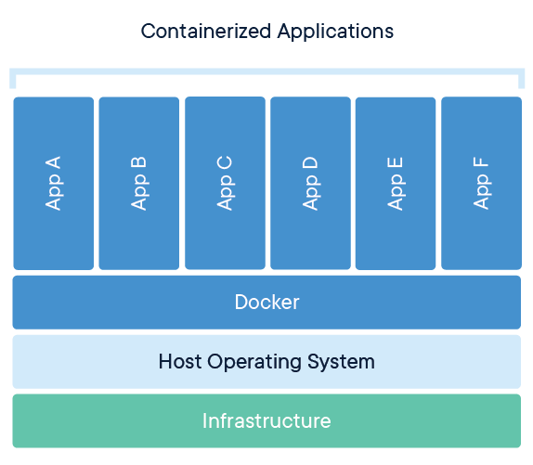
Docker
Virtualization tool
Run applications on isolated environments
Lightweight Virtual Machines

Slide 10
5
What is Kubernetes

Slide 11

Kubernetes
Container Orchestrator
Controller
Pods
Containers
Services

Slide 12
6
What will we be doing

Slide 13

Resources
https://github.com/data-max-hq/workshop-mlops-epoka

Slide 14
1
What is A/B testing
Hands On
2
What is Kubenetes
3
What is Helm
4
What is seldon
5
Hands On

Slide 15

Where are we now
Train a model

Slide 16
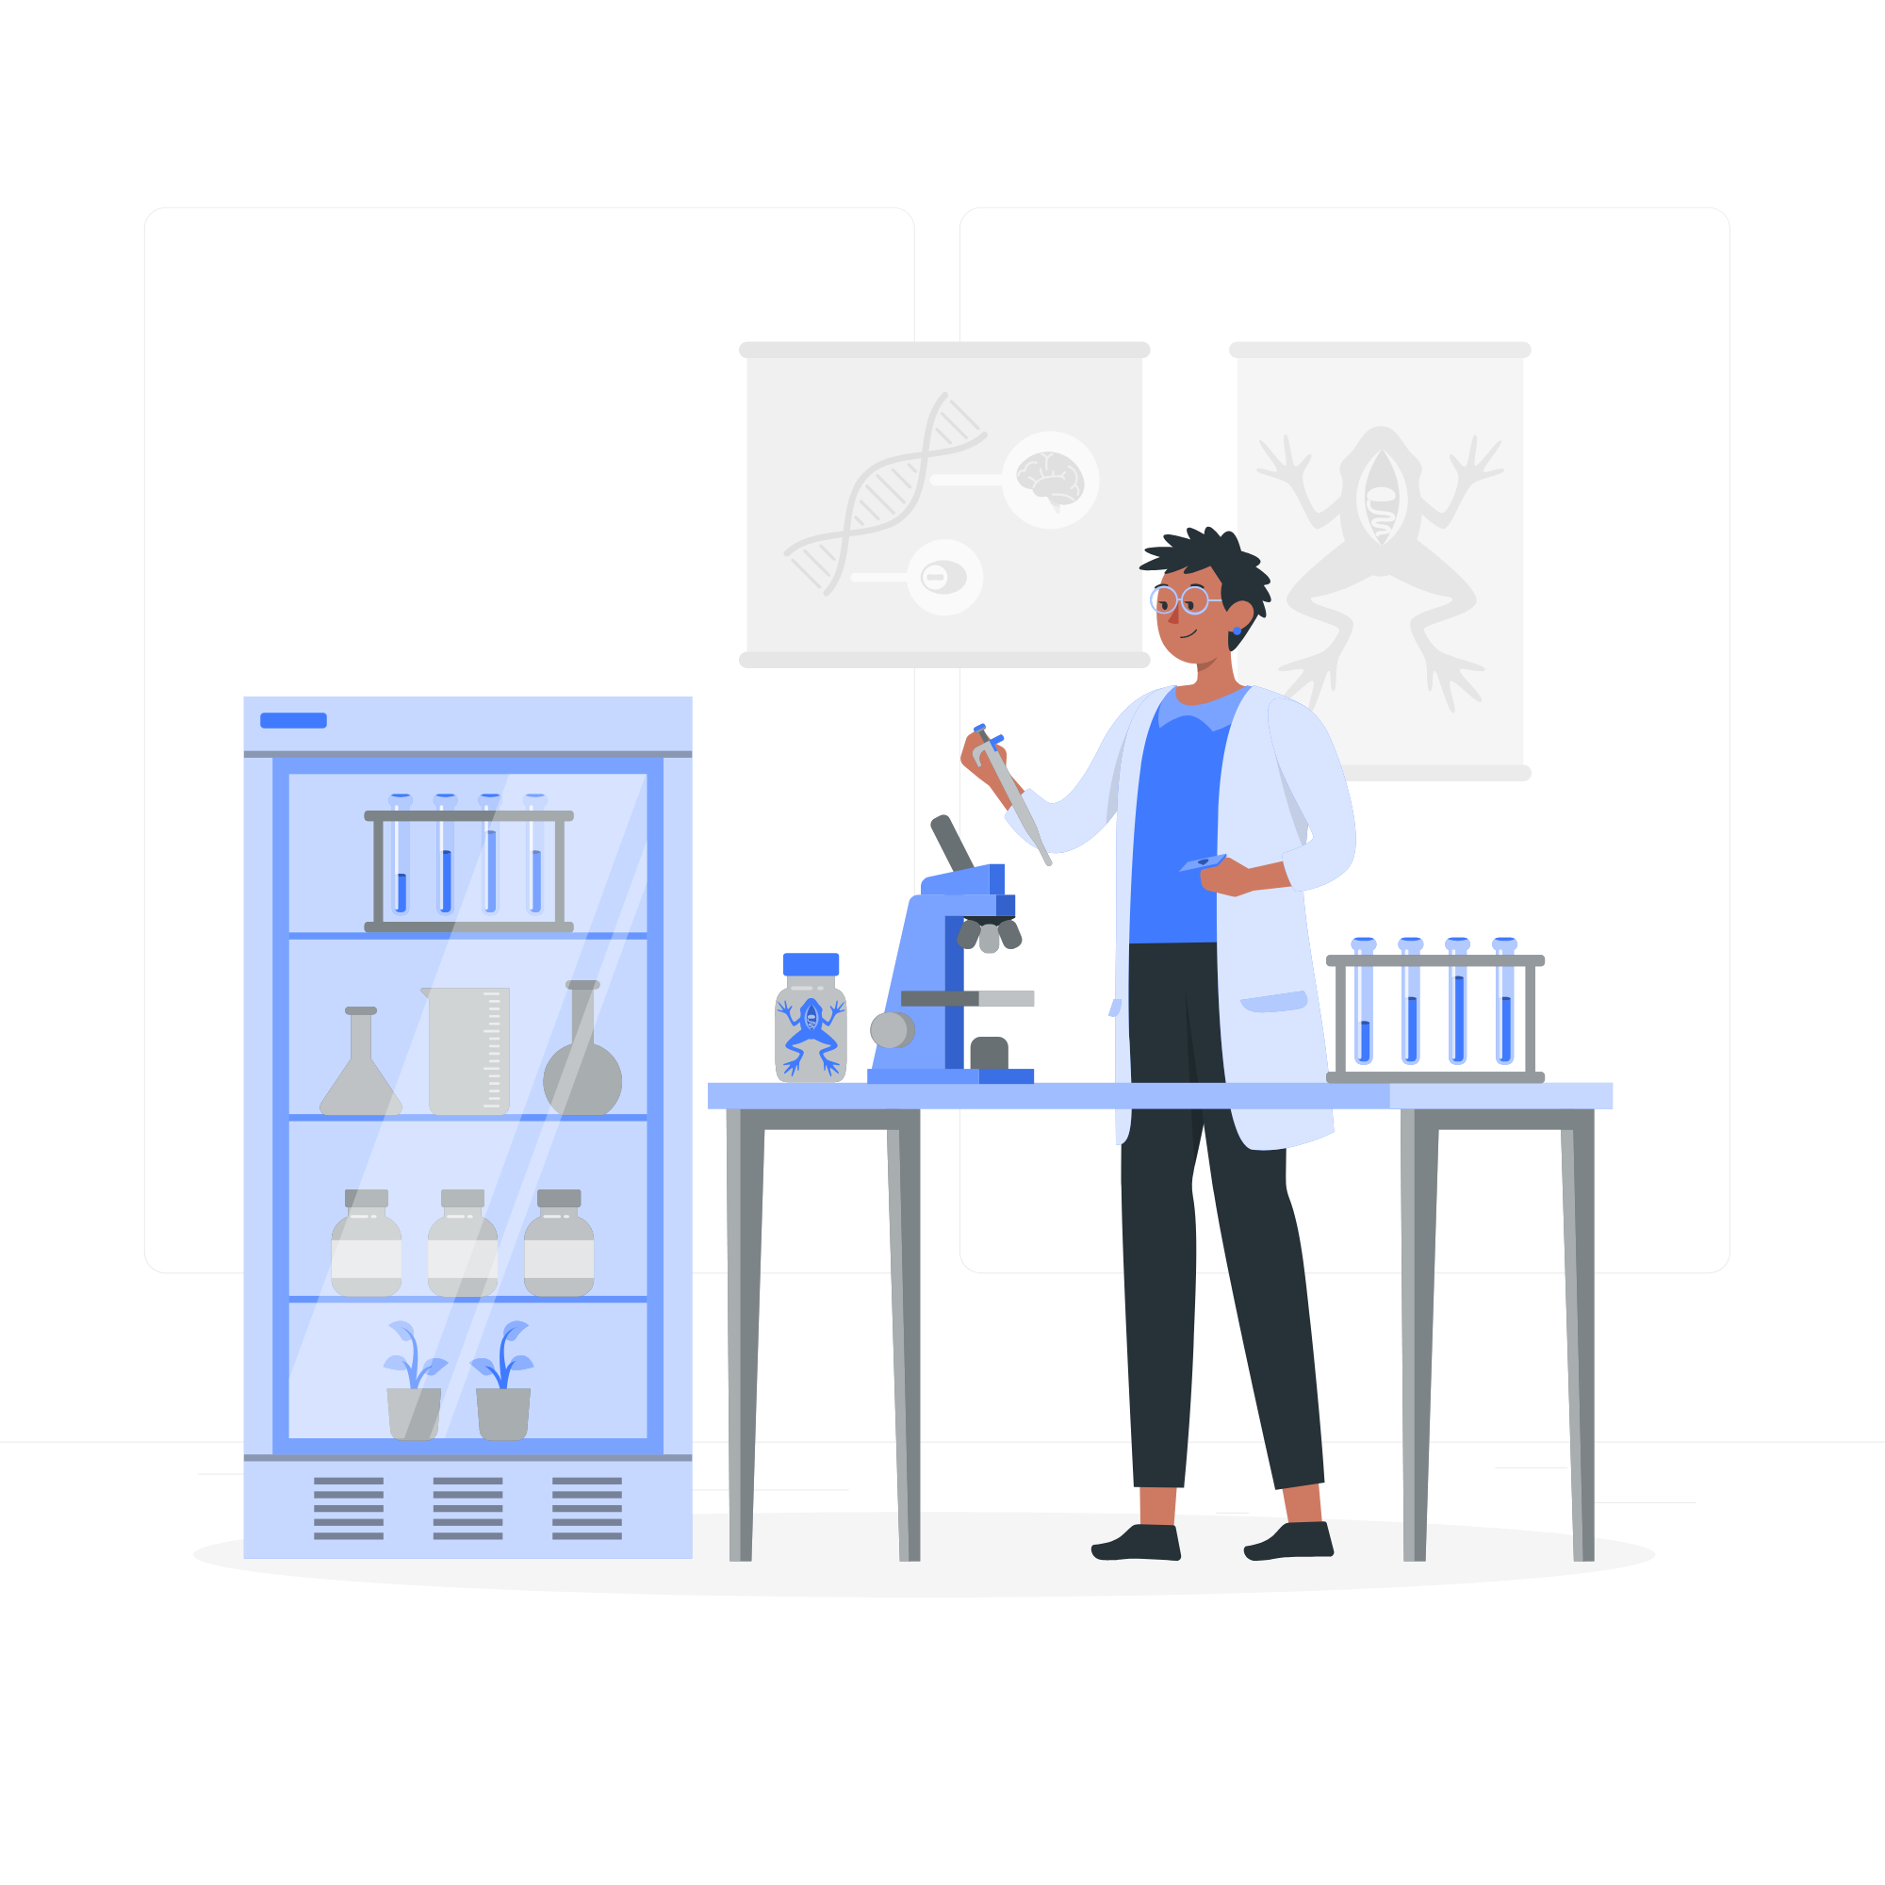
Where are we now
Test the model

Slide 17
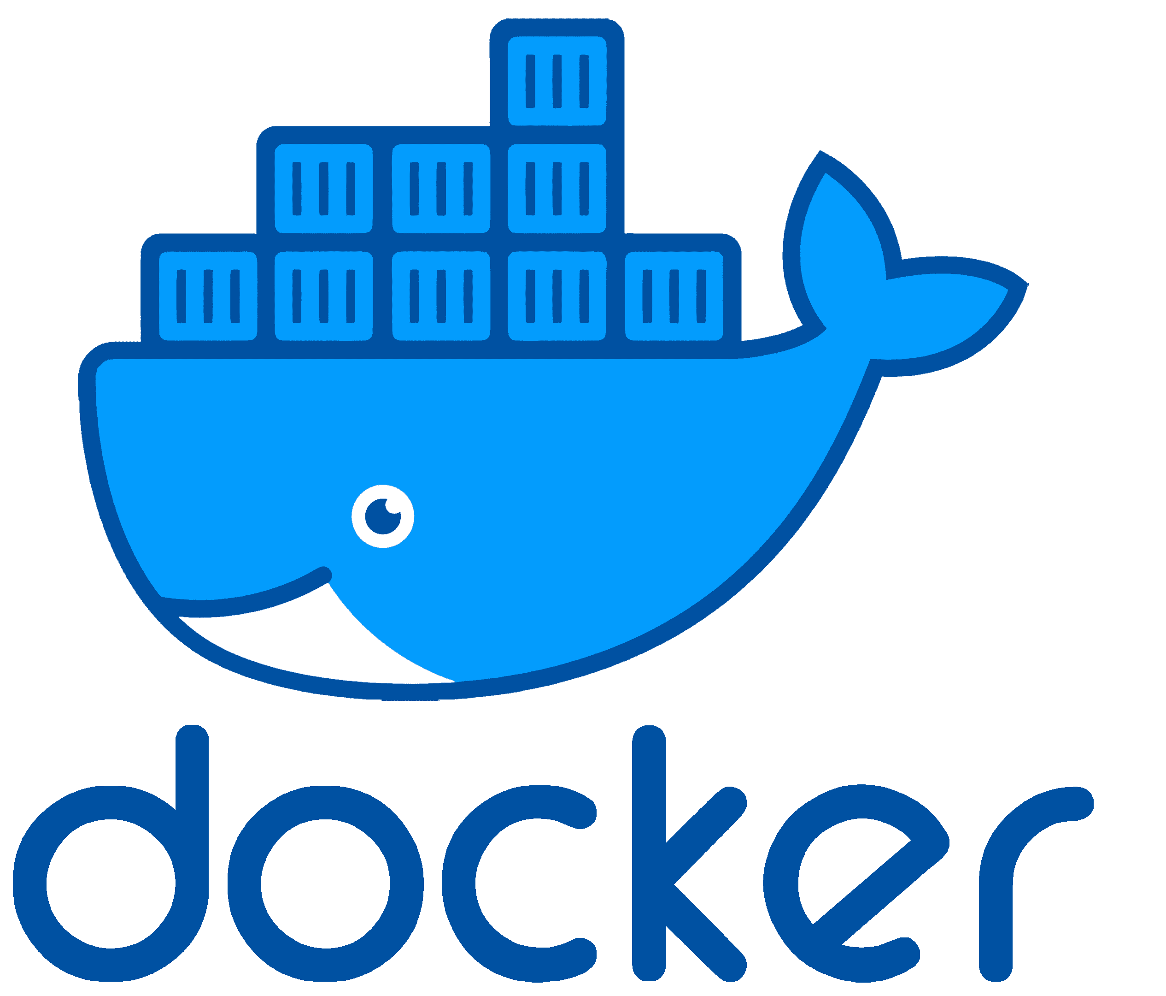
Where are we now
Serve with Docker

Slide 18
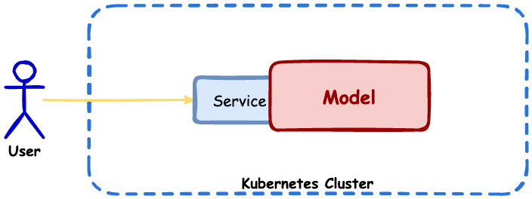
Where are we now
Serve with Docker on K8s

